Slide 1
Inventory system within android devices

Slide 2
Inventory system within android devices
Inventory system is used through almanara program to do the inventory process with more easily and flexible way for all items that are existed within store.
Some notes
After upload the application on mobile device, shown at the beginning a certain code for the application, you must call the technical support department within almanara company.
User must sent the shown code on the mobile device to the technical support department to send the activated code that must be entered to make the inventory application on the device.

Slide 3
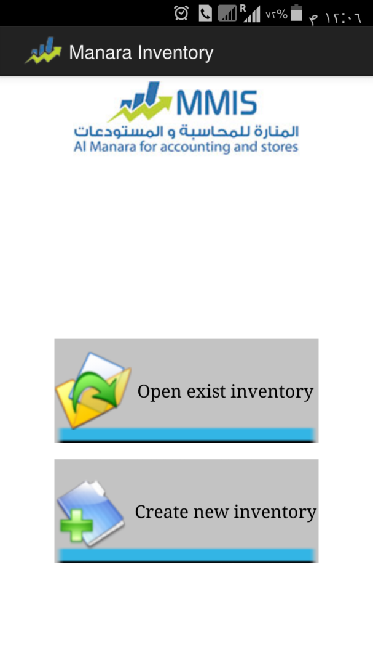
Inventory system within android devices
When you open the inventory application this page will be shown:
This page considered as the main page for the application, which through it the inventory process done more easily.
The main page of the inventory system within android:
1- Open exist inventory.
2- Create new inventory.

Slide 4
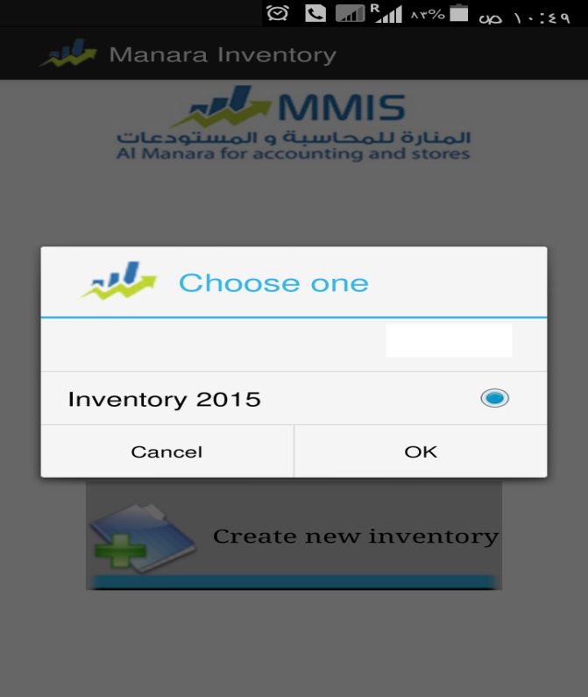
Inventory system within android devices
Open previous inventory:
This button is used to open an inventory file done before.
Which an windows shown which contains all inventory files which done before.
When selected certain inventory file that was shown in the window an new window will be open. Press ok to confirm the data that was been added and press cancel to get out from this window.

Slide 5
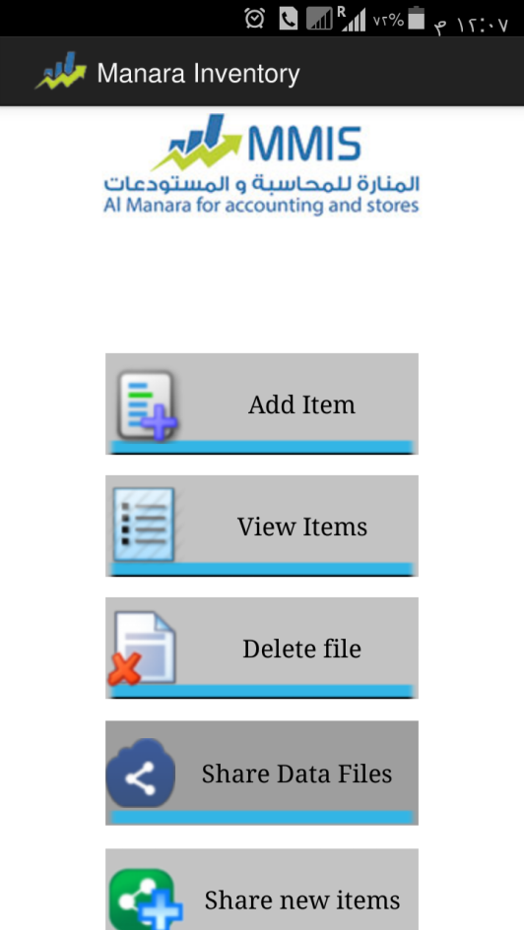
Inventory system within android devices
By pressing “ok” this window will be shown:
Adding item
View item
Delete file
Share inventory file
Share new items

Slide 6
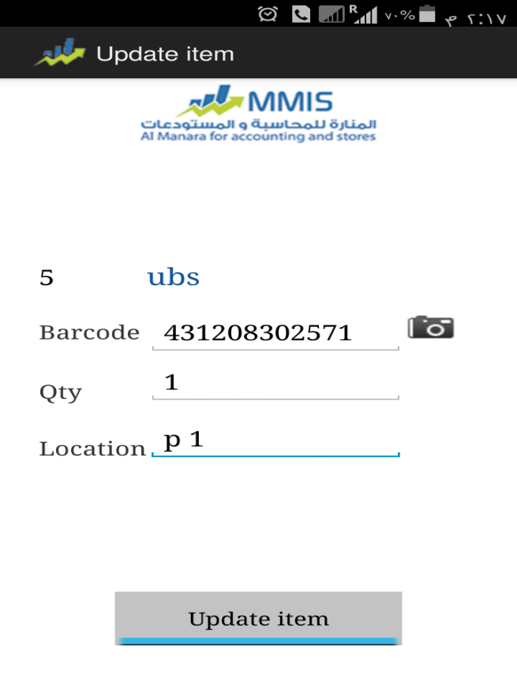
Inventory system within android devices
Add item: This window used to add new items through inventory process and its not defined before within the program which you can select the place of item and its quantity and its barcode.
When you press on the add item button this window will be shown:
Special barcode is added to item to be defined
Identify the amount of the item within the store
Locates the presence of item in the store

Slide 7
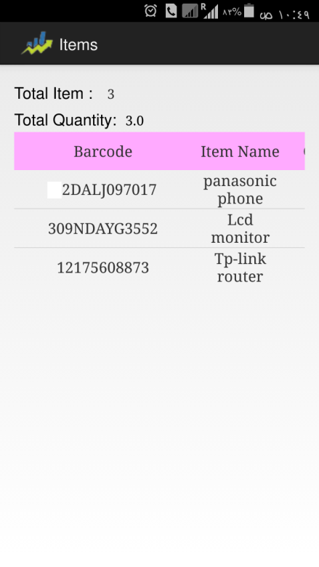
Inventory system within android devices
Show item: This option is used to show all items that was invented which appear its number, quantity, price and the barcode for each item.
And also it is deleted or modify any item found in the inventory file by pressing length on the item name.
Which this window appear:
We also note within this option displays the names of the additives and quantities and prices as well as the site that exists within each item.
On the other hand this option displays the number of items for statistical process and total quantity of items.

Slide 8
Inventory system within android devices
Also you can press by the right button on the item name to do several operation which a window appear contains:
Modify item: Used to modify on the item which a window appear contains information about an item and its barcode, quantity and location.
Delete item: Used to delete item which an a message appear that the item was deleted successfully.
Also you can through opening the show item window and pressing on the left button, appear option (show collected item) which by this option you can collect items that has the same barcode and location, and if the name and the Barcode was repeated then collect items didn’t done.

Slide 9
Inventory system within android devices
Cancel inventory file: This option used to delete the inventory file, where a message appears to confirm the deletion process this process considered dangerous process must pay attention when done.
Share Inventory Files: This option is used to export a file or several files at one time one of the means through which appear on the mobile phone screen (Bluetooth _ Skype _Gmail _Outlook…).

Slide 10
Inventory system within android devices
Through the inventory system you can control with many setting or language by pressing on the left button that exist through the device and selecting on the setting which this options will appear:
Setting: this option used to control with many inventory setting (allow to add new item, and other).
When you select on the setting the application setting appear:
Application setting window contains:
Allow to add new items: by activating this option user will be able to add anew items through the inventory process.
Get barcode by using the camera: by activation this option user can add items by the phone barcode only.
Get barcode manually: by pressing on this option user can add items manually.
You can press on the cancel button to return back on the modification that done and pressing on the save button to save the setting to confirm data.
Also you can control with the field that you want to show (show item name and others…)

Slide 11
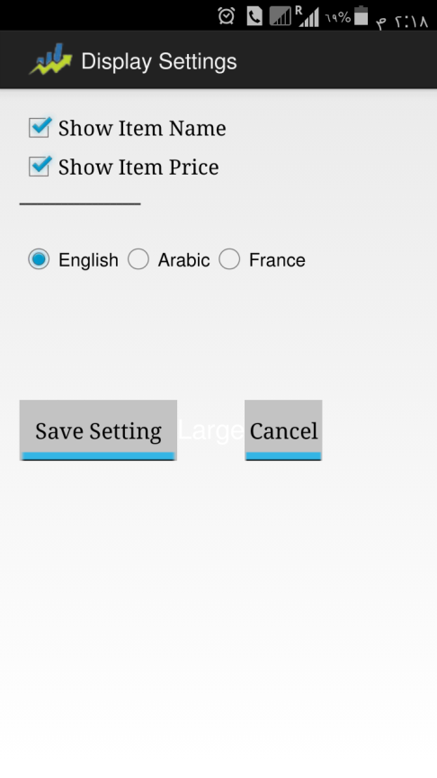
Inventory system within android devices
When select the show setting windows appear:
Show setting window contains:
Show item name: when activating this option through the show item window afield appear contain items name that was entered through the inventory process.
Also you can through this window you can control with the language that you want to show the inventory system by it.
You can press on “cancel” to return of the modification that was done and press on “save setting” to confirm data.

Slide 12
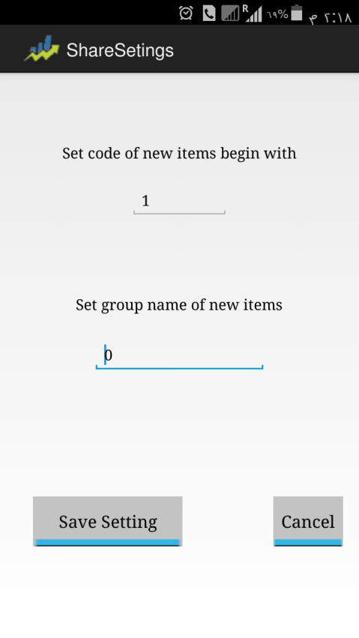
Inventory system within android devices
Also inventory window contains:
Share files setting: To control with the starting code for the new items and for the group items to be added.
Share files setting window contains:
Select the starting code for the new items: Select through code field the code that you want to start coding the new items that was entered within the inventory process.
Select group name for the new items: Select through this field the group name that you want to add the new items to it, and that you was entered through the inventory process.
You can press on “cancel” to return of the modification that was done and press on “save setting” to confirm data.

Slide 13
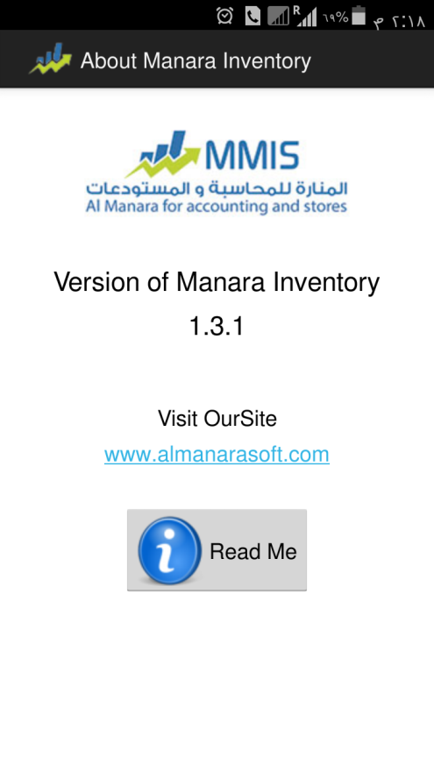
Inventory system within android devices
Also inventory report contains:
About: To show the help file that is related with the inventory system which contain specific explanation for all steps that the user must follow.
About window contains the website for almanara soft company.
Also contain the current application version number, and help button that will show by pressing on the help file that is related with the application which contain an explanation for the work method on inventory application

Slide 14
Inventory system within android devices
Important note:
Inventory can be pre-existing items by importing them from AlManara soft, for example, the file you must export it and arrangement from right to left:
Price | Item | Unit 1 barcode | Unit 2 barcode | Unit 3 barcode
20$ | Tea | 258963 | 369852 | 8596325
30$ | Coffee | 1478965 | 123654 | 124596

Slide 15
Inventory system within android devices
General notes:
Within almanara program is exported items inventories to an Excel file and must be composed of at least the first two fields the symbol and the second item name as explained previously.
And can put more than one column of the barcode by units within almanara program that the number of columns and a maximum of up to five barcode columns, and in the end must save the file type: Text Tab Delimited suffix of type .TXT
Inventory of undefined items can be on the program and when adding un known barcode in the inventory file, the request to add the item name and will exported these items through the new item button.
Inventory files are saved in the phone's memory or mobile device within the folder Inventory Data if the item was adding by barcodes can be added to the name of the item in the Arabic language, but if you add item manually you can add item in the English language only.

